Slide 1

Inference
Confidence Interval for Proportions
Adriano Zambom

Slide 2
Confidence Interval
A conﬁdence interval (CI) is an interval of values computed from sample data that is likely to include the true population value.
Confidence Level is a percentage that tells us the chance that the interval will include the true parameter.
Interpretation:
CI: (0.5, 0.6) with level = 95%
we are 95% conﬁdent that the proportion of males at CSUN is between 0.5 and 0.6.
Adriano Zambom

Slide 3

General Confidence Interval
CI is constructed as
Sample Estimate Multiplier X Std.Error
or
(SampleE – m x s.e., SampleE + m x s.e.)
Note: Margin of Error: ME = m x s.e.
Adriano Zambom

Slide 4
What affects the Width?
CI = (SampleE – m x s.e., SampleE + m x s.e.)
Sample size n
The sample proportion
The multiplier
Adriano Zambom

Slide 5
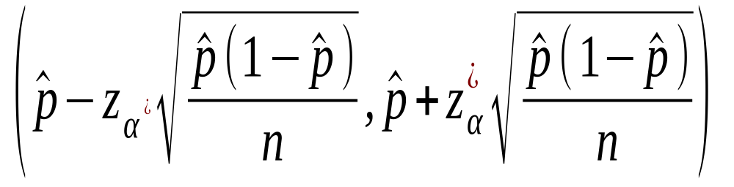



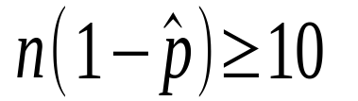
CI for One Proportion
General: (SampleE – M x s.e., SampleE+M x s.e.)
Conditions: and
Confidence Level: | Multiplier:
90% | 1.65
95% | 1.96 (rounded to 2)
99% | 2.58
Adriano Zambom

Slide 6
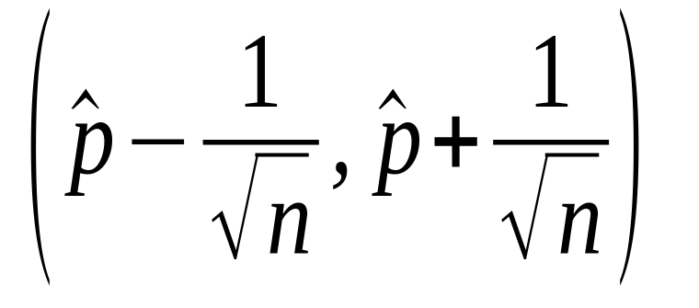
Conservative
CI for One Proportion
Adriano Zambom

Slide 7

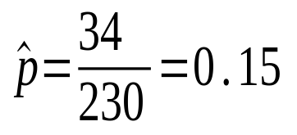
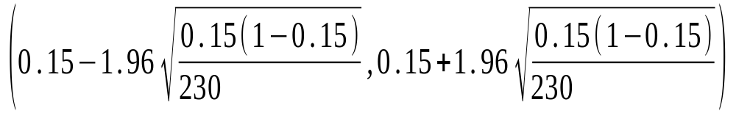
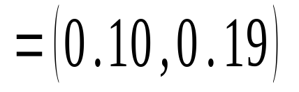
Example
In a sample of 230 soccer players, 34 were left footed. What can you say about the proportion of left footed players of the entire league with 95% confidence?
n = 230
CI(95%) =
Conclusion: With 95% confidence, the proportion of left footed players in the league is between 0.10 and 0.19.
Adriano Zambom

Slide 8
Example
In a sample of 230 soccer players, 34 were left footed. What can you say about the proportion of left footed players of the entire league with 95% confidence?
n = 230
CI(95%) =
In R: prop.test(x = 34, n = 230, p = 0.5, correct = FALSE)
Adriano Zambom

Slide 9
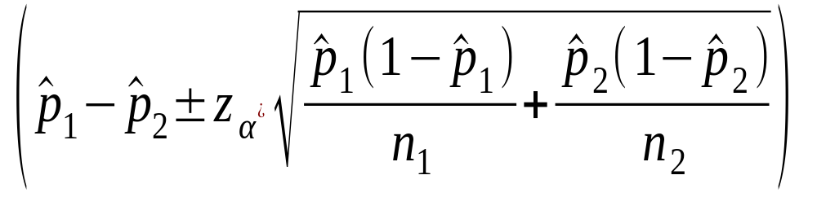
CI for Difference in two Population Proportions
Adriano Zambom

Slide 10

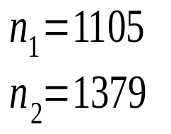
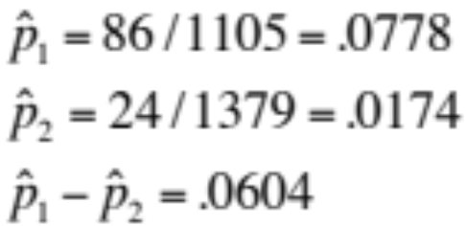
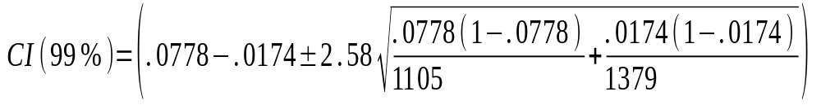

Example: Snoring and Heart Disease
1105 snorers: 86 had heart disease
1379 non-snorers: 24 had heart disease
Conclusion: With 99% confidence, the difference in the proportion of people with heart disease between the snores and non snorers is between 0.038 and 0.083.
Adriano Zambom

Slide 11
Example: Snoring and Heart Disease
1105 snorers: 86 had heart disease
1379 non-snorers: 24 had heart disease
In R: prop.test(c(86,24),c(1105,1379),correct=FALSE)
Adriano Zambom

Slide 12
CI and Decisions
1. Value in the interval THEN acceptable with 95% confidence
2. Value not in the interval THEN not likely to be the true
3. CI for difference in two proportions
doesn’t include 0 THEN proportions are different
4. CI for two different proportions
don’t overlap THEN two pop. Proportions are different
Adriano Zambom

